Slide 1
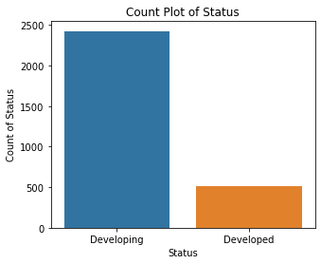
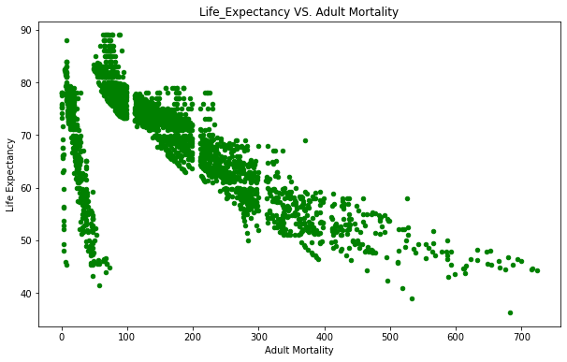
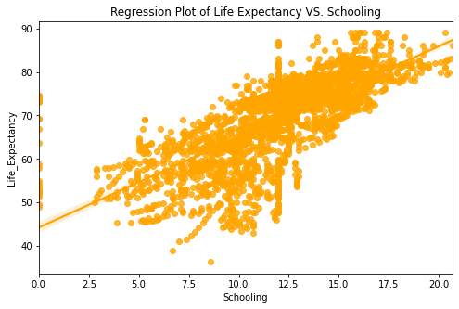
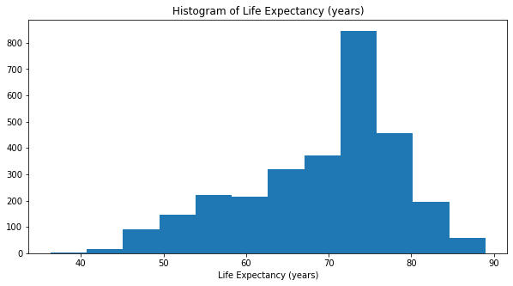
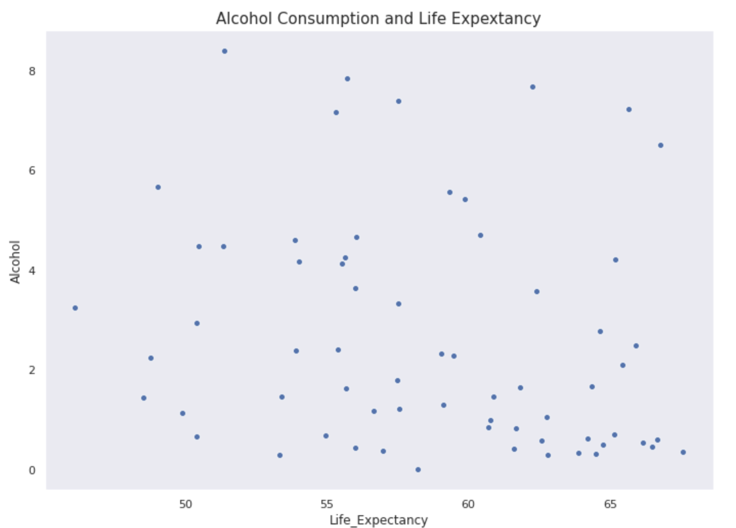
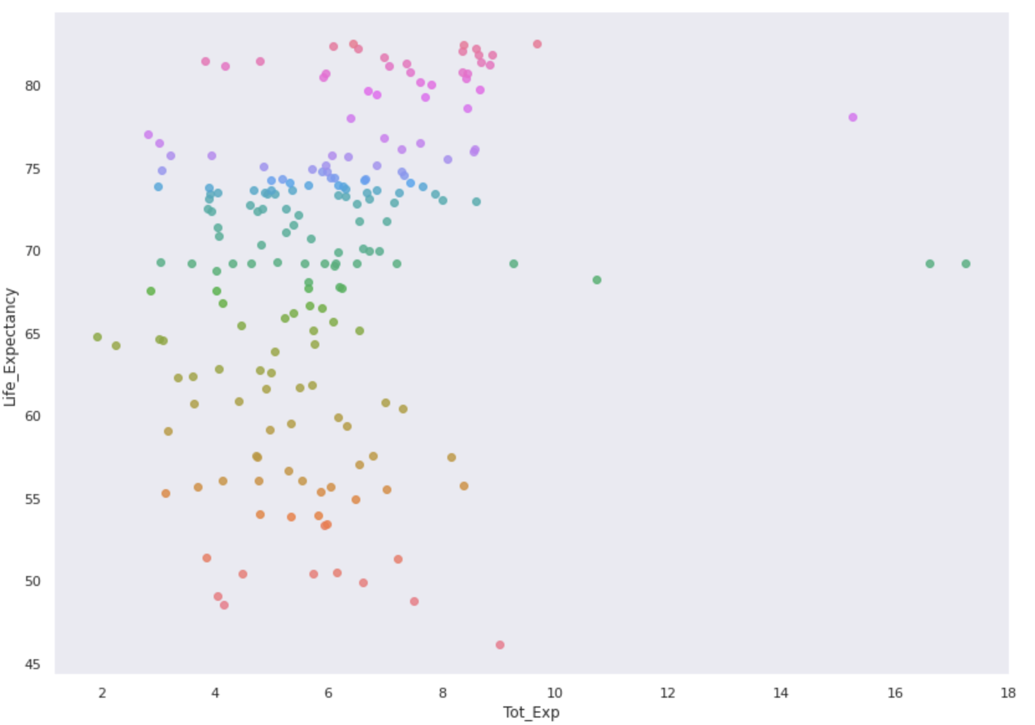

Multiple Linear Regression To Predict Life Expectancy
Yordanos Alemu, Kelsey Dinndorf, Lerang Gaositwe | Data Analysis and Visualization (DS320) | January 27th , 2021
Introduction
Visualizations
Results
Life expectancy is a measure that is often used to gauge the overall health of a community. Shifts in life expectancy are often used to describe trends in mortality. Being able to predict how populations will age has enormous implications for the planning and provision of services and support. As the life expectancy of a population lengthens, the number of people living with chronic illnesses tends to increase because chronic illnesses are more common among older persons.
Goal: Develop a regression model to predict the life expectancy (in years) based on things like immunization factors, mortality factors, economic factors, social factors and other health related factors.
Comparing result from regression model ran:
Our final regression model used Life Expectancy as a target variable and Adult Mortality Rate, Income Composition Resources, Years of Schooling, and Status.
Training set had an R^2 = 0.714
Testing set had R^2=0.733
For unit increase in adult mortality rate, life expectancy decreases by 4.11 years
For each increase in income composition of resources, life expectancy increases by about 2.04 years
For each increase in number of years of schooling, life expectancy increases by about 2.97 years
Developing countries have a life expectancy that is 0.9 years less than developed countries
Developed vs Developing
Total number of infant deaths for developing countries is 88,268, but for developed countries, it is only 765.
Developing countries appear to have the highest Total expenditure compared to Developed countries
Developing countries consume almost twice the amount of alcohol than developed countries
Data
Model
Data Cleaning
Checked for missing values and outliers
Replaced missing values with mean
Tried removing outliers with Z-score (removed too many rows)
Feature construction
1-hot encoded categorical data (country, year, status)
Feature-scaled numerical data
Exploratory Data Analysis
Basic statistics, attribute descriptions
Correlation
Histograms, Bar Charts, Scatterplots, Box Plots, Pie Charts, Regression Plots
Multiple Linear Regression Model
Split data into training and test sets (80/20)
Applied linear regression model on training set and evaluated accuracy using test set
R-squared, RMSE, coefficients
Attributes used in the model: Adult Mortality Rate, Income Composition of Resources, Years of Schooling, Status
Ran model again after removing 10 countries that did not have data for all 16 years
Dataset: Life Expectancy Data
Includes characteristics to predict the life expectancy (in years) of a person from the years 2000 to 2015 for 193 countries.
Found on Kaggle, but originally obtained from the Global Health Observatory (GHO) data repository under the World Health Organization (WHO).
Number of Rows: 2,939
22 Attributes:
Country
Year
Status (Developing or Developed)
Adult Mortality Rate
Infant Deaths
Alcohol consumption
Hepatitis B, Measles, Polio, Diphtheria
Average Body Mass Index (BMI)
Number of Under 5 (years) Deaths
HIV/AIDS deaths
GDP per capita
Income Composition of Resources
Thinness (various young ages)
Years of schooling
Conclusions
Alcohol alone does not seem to be impactful in countries with less than 65 life expectancy
Total expenditure does not appear to affect life expectancy
More factors would need to be considered to assess the impact of alcohol and total expenditure
https://www.kaggle.com/kumarajarshi/life-expectancy-who
Notes:
-For each increase in adult mortality rate, life expectancy decreases by about 4.2 years.
-For each increase in income composition of resources, life expectancy increases by about 2.2 years.
-For each increase in number of years of schooling, life expectancy increases by about 3.3 years.
-model that explains all of the variation in the response variable around its mean.

